Slide 1



Final Year Project
CODEBLACK
Cryptocurrency Prediction Software

Slide 2




OUR TEAM
CODEBLACK
Bernard Joshua
Lionel
Danial Imran
Cheong Ming Xuan
Team Leader
Data Engineer
Frontend Quality Manager
Backend Engineer
Scribe
Frontend Engineer
Backend Quality Manager
Frontend
Backend Engineer ( Reserve)

Slide 3
Project Background

Slide 4
Cryptocurrencies Forecasting
Employer
U Mobile Sdn Bhd
Project Problem
Use Machine Learning and Data Science expertise to predict real crypto market data to forecast short term returns in 5- 10 popular cryptocurrencies.
Tasks
Design and Develop a Crypto Prediction Software
Conduct Research on Machine and Deep Learning Algorithms

Slide 5
SEPA ( Part A of The Project )

Slide 6
Outline Of Part A
Project Plan
Software Requirements
Software Design and Research
Test Plan
Prototype

Slide 7
Project Plan

Slide 8
Terms of Reference
Objectives
The success of the project is determined by how well the objectives are met.
Scopes
What the project will and will not accomplish and the earliest start and latest finish dates.
Critical Success Factors
Ways of measuring if you’ve met the objective.
Acceptance Criteria
How the client will determine if the software is acceptable.

Slide 9
Objectives
Come up with a comprehensive report on best suited machine learning algorithms to be used in predicting cryptocurrencies.
Machine Learning Software/Algorithm with an acceptable degree of accuracy.
User Interface with good heuristic principles met.
Exploring availabilities for project enhancements. ( Scalability, Security and Cost Effectiveness )

Slide 10
Scopes
Within Scope:
Will research machine learning algorithms and decide on the best possible one to use to predict cryptocurrency performance.
Will look for ways to ensure the scalability, security, and maintenance of the application/software in the long term would be feasible.
Integrate the machine learning algorithms with web services for deployment.
Follow industry standards for frontend, backend development and documentation.
Out of Scope:
Integrate any sort of blockchain systems into the software.

Slide 11
Critical Success Factors
Factors | Description
Knowledge and expertise of the team. | As all team members are still university students. How much the team manages to learn before developing the project will greatly influence the research of the machine learning algorithms as well as the development of the prediction software.
Timeline and team’s personal schedule. | Due to the team being full time university students they may have additional workload from other subjects they are taking that semester. This would affect the amount of effort that the team can put into the project and may result in some deadlines not being met, especially during exam periods.
Support from Client | Getting the necessary support such as data and feedback from the client will also greatly influence the projects success.

Slide 12
Acceptance Criteria
Acceptance Criteria | How the Client would Measure This
Prediction algorithm has an accuracy of atleast 40% | Client will be able to measure this by comparing the predictions of the algorithm to the closing price of the cryptocurrency in question over a span of one week.
User Interface has at least 90% of heuristic principles met. | Client can measure this with revieing the specific usability requirements that the team has carried out. If 90 percent of the requirements are met then the criteria is met.
Software has acceptable scalability. | Client can carry out a scalability analysis to estimating how its performance varies as a function of the input size growth and the numbers of processors.
Software’s security meets the specific ISO/IEC 9126 standards for quality. | Client can review results of the teams quality testing and determine if it meets the clients standards or the client can carry out a full security risk assessment on it.

Slide 13
Establishment
Processes, Procedures And Standards
Project Environment
Skill Development Requirements
Agile Development
Industry Standard Coding Practices
Room in INTI Subang
Personal Laptops
Azure Web Apps account
Firebase account
Machine Learning
Algorithm, Azure
Web Apps and
Firebase usage
ASP.net

Slide 14
Deliverables, Activities And Capital Resources
Deliverables
Prototype of the UI by first phase.
Working software by end of second phase by second phase.
Test results for UI
Test results for Prediction Algorithm
User manual for Application
Debug manual for Application
Activities
Research of UI Frameworks.
Research of the Machine Learning Algorithms.
Development of User Interface.
Development of Prediction Algorithms
Testing UI of the Application
Testing Prediction Software ( Backend )
Security Testing ( And any other tests )
Resources
Budget/ account to access to Microsoft Azure which will be provided by INTI or U Mobile. (To be confirm)
A room that will be used to carry out our physical meetings and development

Slide 15
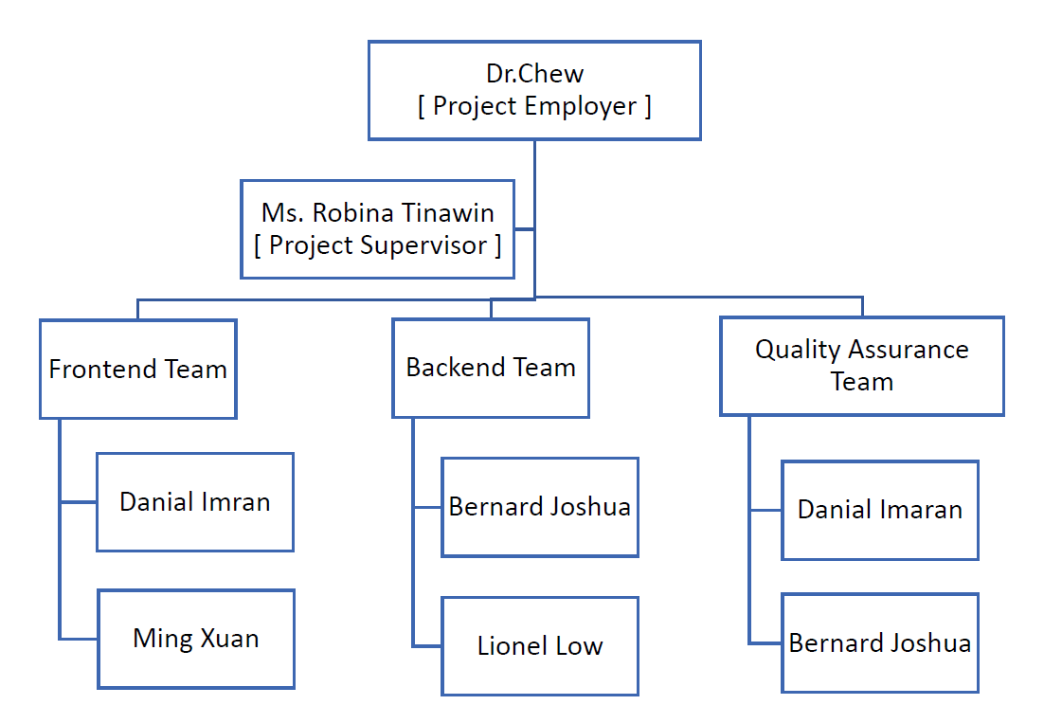
Organisational Structure

Slide 16
Risks
Rank | Description | Occurrence Probability (H/M/L)
1 | Miscommunication or Lack of Communication causing confusion | M
2 | Project schedule not properly defined/ misunderstood | L
3 | Conflicts during project which are unable to be handled within timely manner | L
4 | Delays on earlier task affecting ability to complete | M

Slide 17
SCHEDULE PROJECT TIMELINE Please refer to the Gantt chart ( Excel File ). EXTERNAL DEPENDENCIES No known external dependencies needed. ASSUMPTIONS Assumed each sprint will need 2 weeks and each activity within the sprint can be completed within that time frame. The project plan also assumes that 5 sprints will be enough to finish the project.

Slide 18
Budget
Personnel Cost
RM 5 per hour for each member.
Time Estimate To Complete Task
5 Sprints
2 Weeks per Sprint
Total 70 Weeks.

Slide 19
Software Requirements

Slide 20
Scopes , Objectives and Benefits
Application uses | Give predictions about specific cryptocurrencies for the short-term.
In-scope | Web Based Application. Analyses historical crypto data and makes short term predictions. Provides notifications on performance changes/ when to buy or sell the crypto.
Out-Of-Scope | Predict performance of crypto via external market conditions. Convert or download the data into file formats.
Objectives | Give existing U Mobile users better access to crypto investment services. Increase U Mobiles user base.
Benefits | Increase U Mobiles Brand Image. Increase U Mobiles users Increase U Mobile profits.

Slide 21
System Requirements
Software
Windows 7+
MacOS 10.11+
Linux ( Debian 10+ )
Android Marshmallow 6+
IOS 12+
Hardware
Desktop
An Intel Pentium 4 processor or later that's SSE3 capable
Mobile
8GB RAM

Slide 22
Functional Requirements
FR No. | Description
1 | System must allow users to log in via their Google Account or Phone number.
2 | System must allow users to change/reset their passwords.
3 | System must display a graph to show the predicted performance of the crypto.
4 | System must provide a numeric number on the accuracy of the prediction. (In percentage)
5 | System must allow the user to change the type of crypto to predict performance.
6 | System must allow users to save/mark crypto to follow for performance prediction.
7 | System must allow for users to receive notification about a specific cryptos performance if that crypto was marked.
8 | System must allow administrator to notify the user about any changes to the system.

Slide 23
Non – Functional Requirements
Functional Suitability:
Functional completeness: Functions such as performance notification, marking the crypto for performance notification, prediction graphs and accuracy percentages will be added into the application to ensure the users objectives of having necessary information when needed are met.
Measurement: Testing the applications ability to do so by checking if it does present the following when the functions are called.
Functional Correctness: The prediction of the crypto should be available on a weekly basis.
Measurement: Checking the weekly closing prices versus the predicted weekly closing prices. Both should be equal with a margin of error at +/- 10 %.
Usability:
Learnability – GUI interface.
Measurement -To check for learnability, the user should be able to know what each part of the application should do when they use it for the first time.
Operability – GUI interface.
Measurement – To check for operability, the user should be able to navigate within the application and operate each feature without problems to get their desired outcomes.

Slide 24
Non – Functional Requirements II
Reliability:
Availability: Overall application.
Measurement – To check for availability, the user should be able to use the application anytime when they need to. This is if the crypto markets are open.
Recoverability: Overall application.
Measurement: To check for recoverability, the user should be able to use the application and retrieve data in the event of a system failure.
Security:
Confidentiality: 99% of correctness that only those authorizes to have access. Measurement: Log in attempts made wit non-existent accounts/ Attempt to access the application without an account result in a denied access.
Integrity: Normal users do not have administrative privileges.
Measurement: Normal users cannot modify or access sensitive data.

Slide 25
Non – Functional Requirements III
Portability:
Adaptability: The product can be used across multiple different operating systems on multiple different browsers.
Measurement: Testing out the applications use on Windows, Mac, Linux, Android and iOS.
Maintenance:
Modifiability: 99% of functions are easy to modify
Measurement: The functions can be modified without affecting the main application too much or at all.
Testability: 99% of functions can be tested if there are new criteria set.
Measurement: Testing out the new/modified functions and it passes the new or existing criteria’s set.
Performance:
Time behaviour: More than 95% of functions will respond within the response time.
Measurement: Monitoring time while calling the functions.
Resource utilisation: All resources will use a total of 3GB or less/ All resources will use as much resources only when needed ( No background use ).
Measurement: Monitoring of the resources using the PC’s inbuilt “Resource Monitor”

Slide 26
Interface Requirements
User Interfaces
The software will be deployed via web service with a GUI.
Hardware Interfaces
As the software will be hosted through Microsoft Azure Web Apps, hence most of the major hardware like the data servers will be handled by Microsoft.
Software Interfaces
The Cryptocurrency Prediction software shall communicate with Microsoft Azure Web Services for users to be able to access the web and store information there.
Communication Interfaces
This software will be communicating through Azure Web Apps Services.

Slide 27
Design & Research

Slide 28
Architecture
Reason | Description
Multiple Technologies | Enables integration of Microsoft AI tools which can aid in development of the software. In turn this will reduce development time.
High Performance | Parallelism is used by big data solutions to enable high-performance solutions that scale to large volumes of data.
Flexible , Scalable and Cost-Effective | Allows for tailoring of solutions to small or large workloads while only paying for the resources used.
High Interoperability | Components are also used in enterprise BI solutions, allowing for the creation of integrated solution across data workloads.
Chosen Architecture : Big Data Architecture

Slide 29
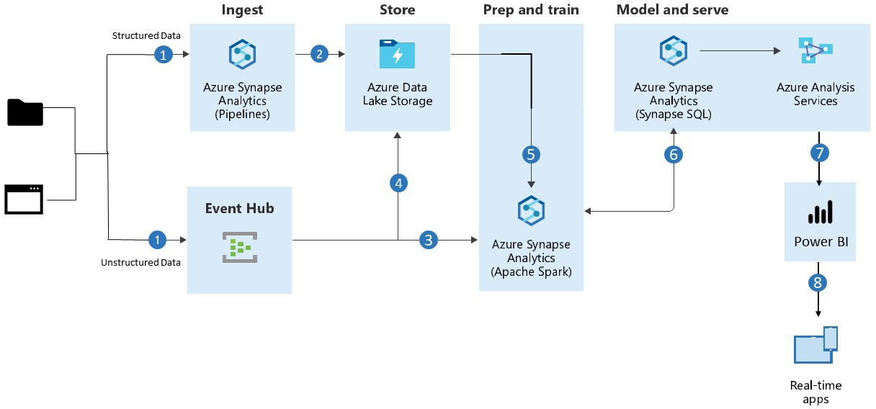
Architecture II
Design Diagram

Slide 30
Assumptions
Software can be completed on time.
- Design is not too complex.
Software changes in one part will have little to no impact on the others.
- Not a lot of dependencies among the components.
The system design manages to encapsulate all the employer’s needs.
- Only three were explored and only one was chosen. The chosen design is the best one that manages to meet the needs the employer has.

Slide 31
Test Plan

Slide 32
Plan
Scope
Testing will take place at various stages of its life cycle.
Testing ensures that bugs and defects are detected earlier on in the development process
Test strategy is now confined to high-level test cases and assumptions.
Test plan will serve as a high-level guide for testing for the time being and will be revised as the system evolves.
Constraints
The team is restrained to testing the software/system on the Azure Cloud platform.
The team is restrained to test the software/system within the cost of $400 in Azure Credits.

Slide 33
Plan II
Assumptions
The testing will be done with the assumption that the user’s have access to the internet.
The testing will be done with the assumption that the user’s are using the Chrome web browser or any other web browser that is compatible with Windows/MacOS/Linux operating systems.
Strategy
The software/system will be tested in four-phases :
Unit Testing
Integration Testing
Systems Testing
Security Testing
Acceptance Testing

Slide 34
SEPB ( Part B of The Project )

Slide 35
SEPB - Plan
Early Development
Start development phase right after final exams.
More Research
To solidify the application development to industry standards.
Better Tracking Processes
To help track progress and meet objectives sooner.
Better Risk Contingencies
To prevent any delays, like in this semester.

Slide 36
Questions ?

Slide 37
End Of Presentation
For Further Details For Phase A Of The Project Please Refer To The Documentation On Canvas.

